Slide 1
ADIOS framework
Models and Callbacks
May 31, 2023

Slide 2
Model (\ADIOS\Core\Model)
Implemented in src/Core/Model.php
Definition of columns, indexes and DB upgrades
DB-related methods, either ADIOS native or Eloquent’s
Support for 1:N and M:N relations
Standardized CRUD operations
13 callbacks currently implemented

Slide 3
Implemented callbacks
onTableBeforeInit($tableObject) : void
onTableAfterInit($tableObject) : void
onTableAfterDataLoaded($tableObject) : void
onFormBeforeInit($formObject) : void
onFormAfterInit($formObject) : void
onBeforeInsert($data)
onModelBeforeUpdate($data)
onBeforeSave($data)
onAfterInsert($data)
onModelAfterUpdate($data)
onAfterSave($data, $returnValue)
onBeforeDelete(int $id)
onAfterDelete(int $id)
3 groups of callbacks:
Callbacks for CRUD
Insert, Update, Save, Delete
Callbacks for UI/Table:
Before/After init
After data loaded
These are the replacement for the tableParams()
Callbacks for UI/Form:
Before/After init
These are the replacement for the formParams()

Slide 4
Legacy “callbacks” (copy&paste from old ADIOS)
tableRowCSSFormatter($data)
tableCellCSSFormatter($data) : void
tableCellHTMLFormatter($data) : void
tableCellCSVFormatter($data) : void
These will be replaced by “new” callbacks:
onTableRowCss
onTableCellCss
onTableCellHtml
onTableCellCsv

Slide 5
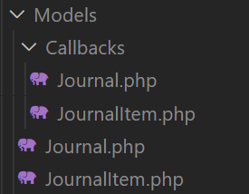
How to work with callbacks
Create a folder “Callbacks” in the folder “Models”
In the example on the right, we have two models “Journal” and “JournalItem” with two separate files for callbacks.

Slide 6
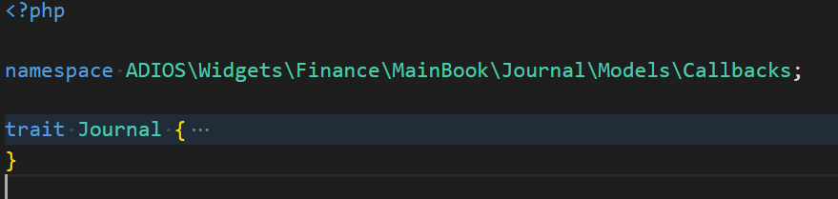
How to work with callbacks
Create a folder “Callbacks” in the folder “Models”
Create a trait in the “Callbacks” folder

Slide 7
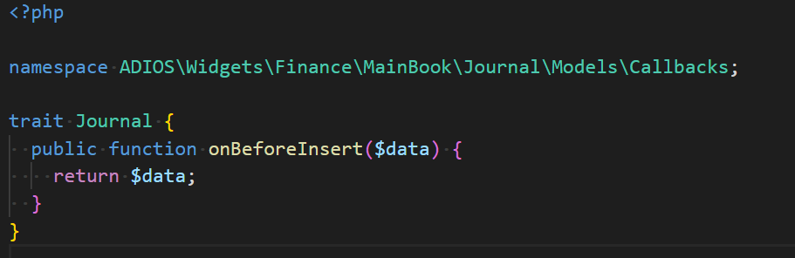
How to work with callbacks
Create a folder “Callbacks” in the folder “Models”
Create a trait in the “Callbacks” folder
Implement the functionality of the callback

Slide 8
How to work with callbacks
Create a folder “Callbacks” in the folder “Models”
Create a trait in the “Callbacks” folder
Implement the functionality of the callback

Slide 9
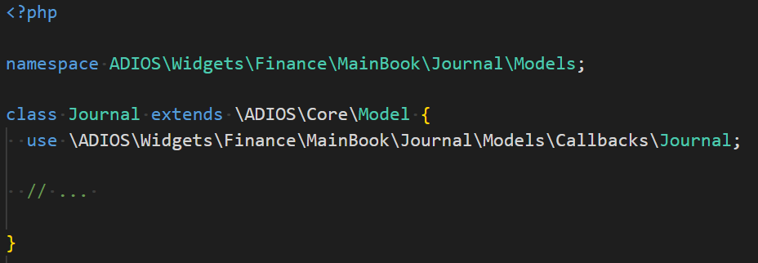
How to work with callbacks
Create a folder “Callbacks” in the folder “Models”
Create a trait in the “Callbacks” folder
Implement the functionality of the callback
Use the trait in the model

Slide 10
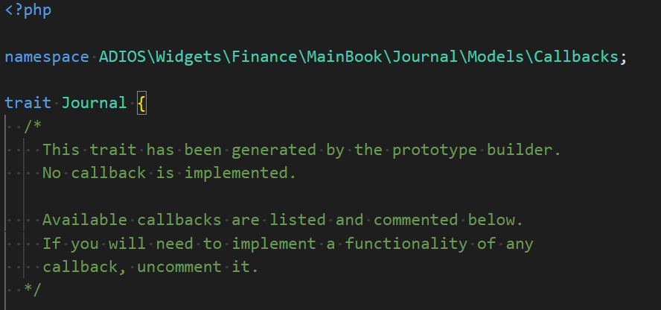
Final words
Implementation of the callbacks is separated from the definition of the model
Prototype builder generates the empty trait for callbacks automatically

